Slide 1

Web Scrapping to gain Company Insights
10/05/2023

Slide 2
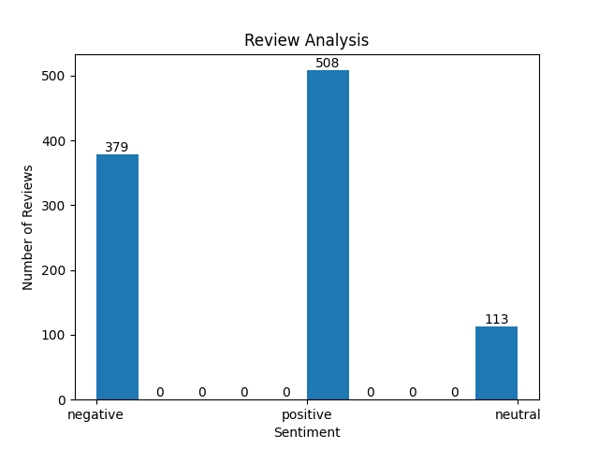
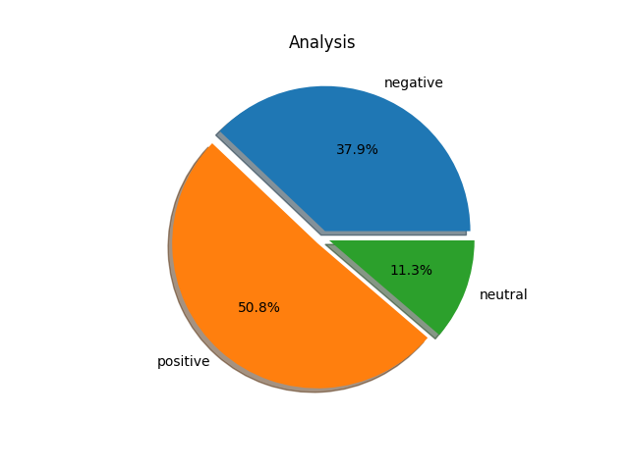
Analysis of Reviews
Histogram analysis of number of reviews
Pie Chart showing percentage of reviews in each sentiment
Total number of reviews scrapped: 1000 reviews

Slide 3
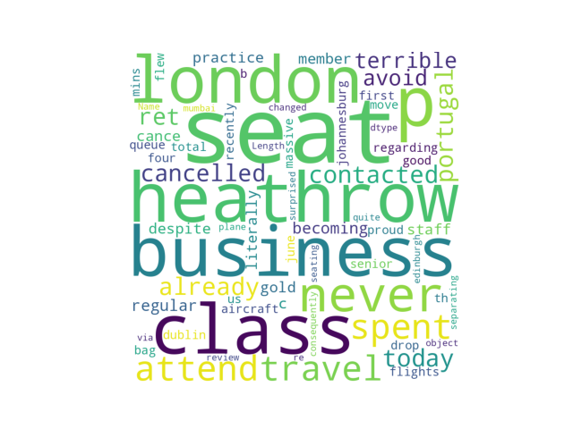
Sentiment Analysis
Among 1000 reviews, most reviews has the following keywords with state different sentiments. Most of the words shown have negative sentiment. Some locations are highly visited like London, Heathrow, Johannesburg.
WordCloud

